Slide 1
4. Vector space

Slide 2
4.1 vector spaces and subsapces

Slide 3
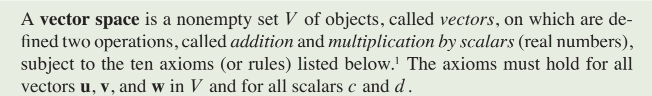

Slide 4
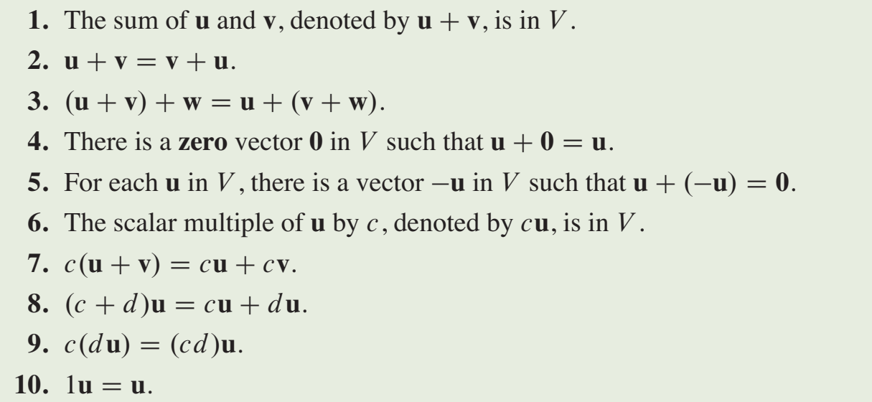

Slide 5
unique
unique

Slide 6
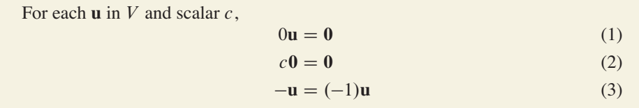

Slide 7

Examples

Slide 8
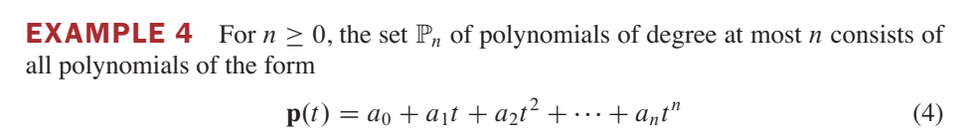
examples

Slide 9
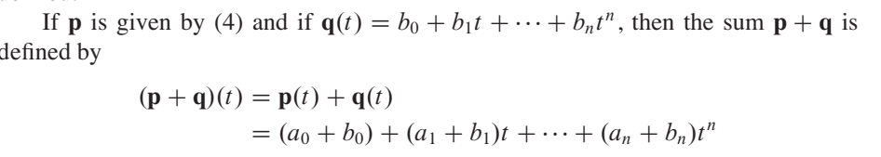

examples

Slide 10
examples

Slide 11
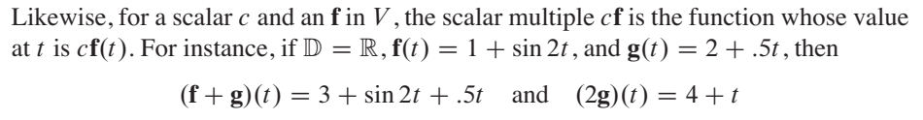
examples

Slide 12
subspaces
In many problems, a vector space consists of an appropriate subset of vectors from some larger vector space.

Slide 13
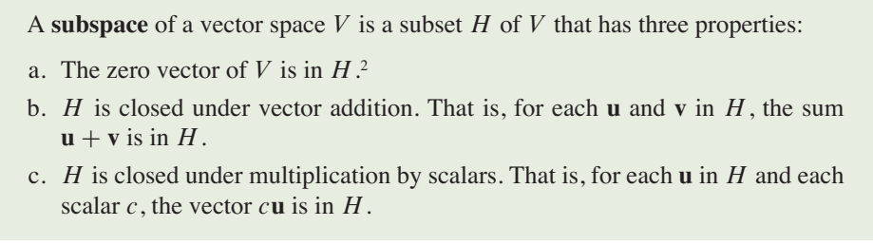
subspaces
In many problems, a vector space consists of an appropriate subset of vectors from some larger vector space.

Slide 14
examples

Slide 15
examples
R2 and R3

Slide 16
examples
R2 and R3
R2 is not even a subset of R3

Slide 17
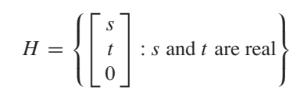
examples
Subspace of R3

Slide 18


examples

Slide 19
A Subspace Spanned by a Set

Slide 20




A Subspace Spanned by a Set

Slide 21
A Subspace Spanned by a Set

Slide 22
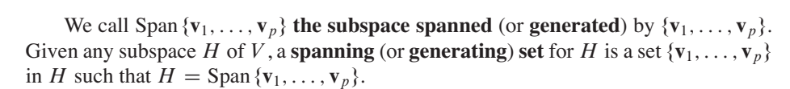
A Subspace Spanned by a Set

Slide 23
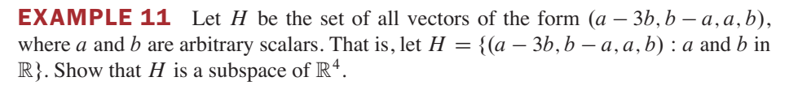

Slide 24
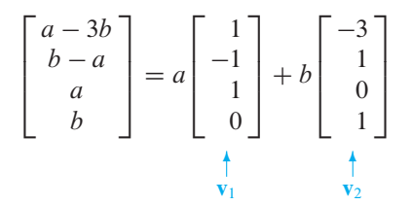

Slide 25


Slide 26
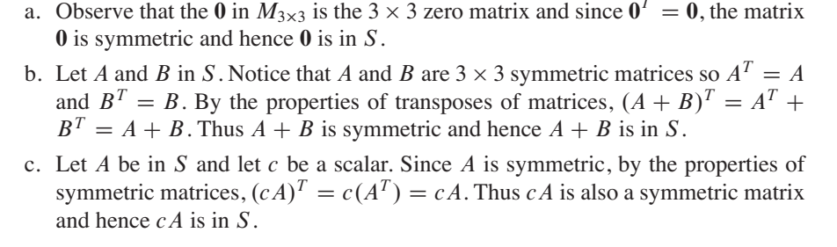

Slide 27
4.2 Null space, column space and linear transformation

Slide 28
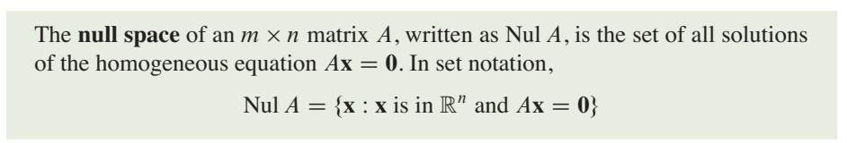
Null space

Slide 29
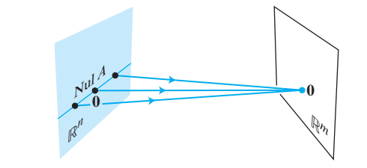
Null space

Slide 30
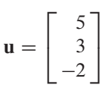

example
Determine if u belongs to the null space of A

Slide 31

example
Determine if u belongs to the null space of A

Slide 32
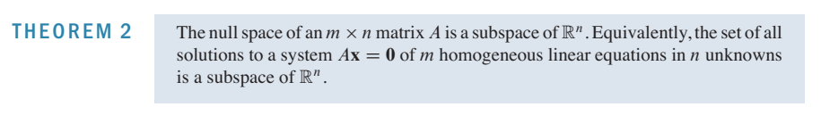
proof

Slide 33


Slide 34
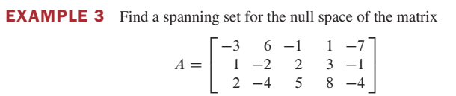
An Explicit Description of Nul A
There is no obvious relation between vectors in Nul A and the entries in A. We say that Nul A is defined implicitly, because it is defined by a condition that must be checked.

Slide 35
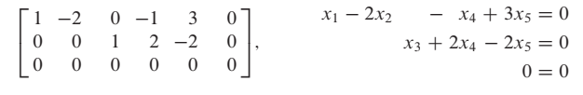
An Explicit Description of Nul A
There is no obvious relation between vectors in Nul A and the entries in A. We say that Nul A is defined implicitly, because it is defined by a condition that must be checked.

Slide 36
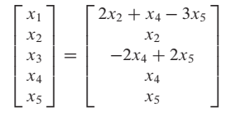

Slide 37
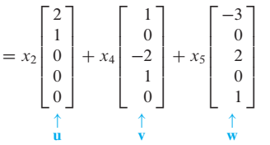


Slide 38
Linearly independent
Number of free variables

Slide 39
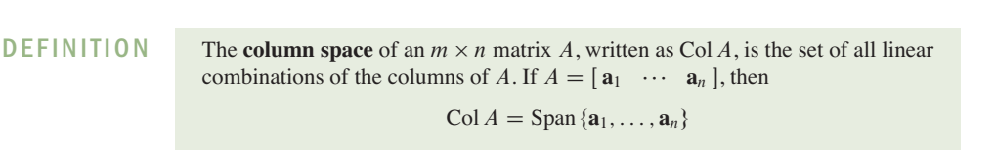
Column Space of a Matrix

Slide 40

Column Space of a Matrix
range of the linear transformation Ax.

Slide 41
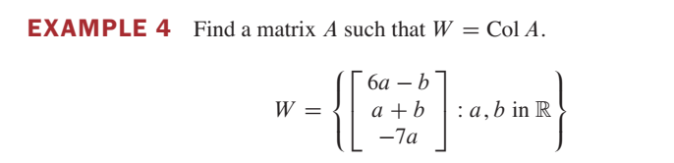
example

Slide 42
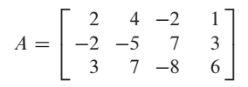
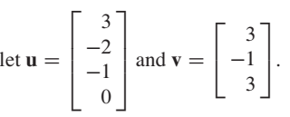

Column space and null space

Slide 43
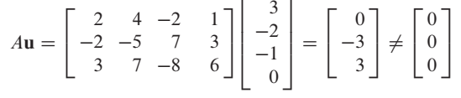
Column space and null space

Slide 44
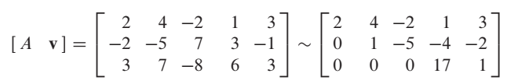
Column space and null space

Slide 45
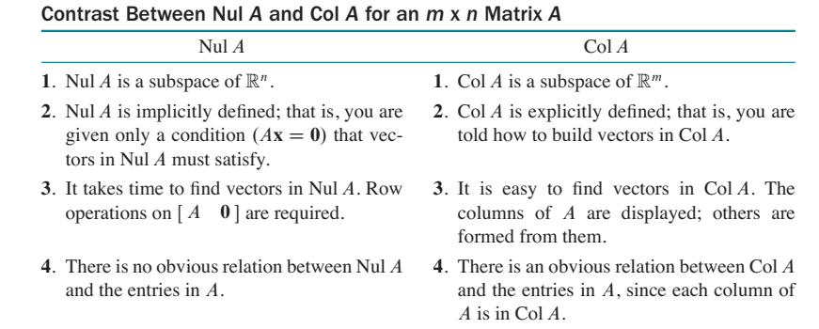
Column space and null space

Slide 46
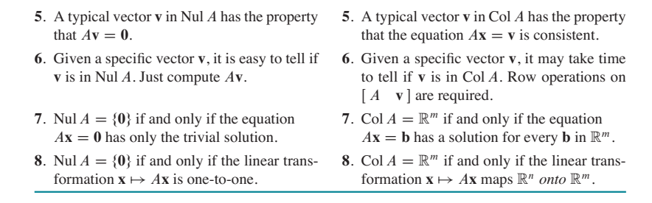

Slide 47
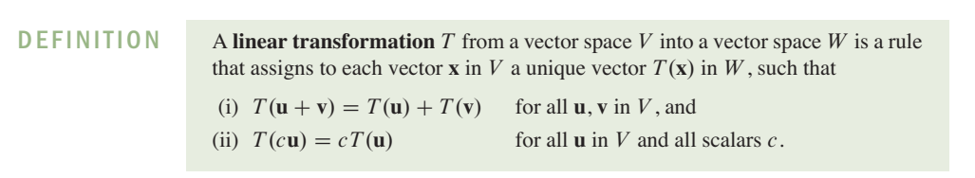
Linear transformation

Slide 48
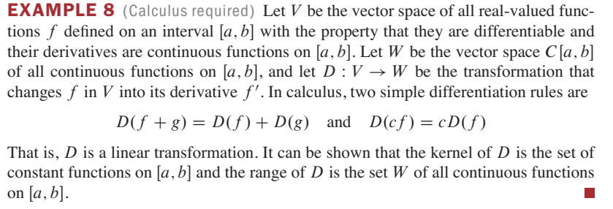
example

Slide 49
4.3. Linearly independent set, bases

Slide 50
subsets that span a vector space V or a subspace H as “efficiently” as possible.

Slide 51
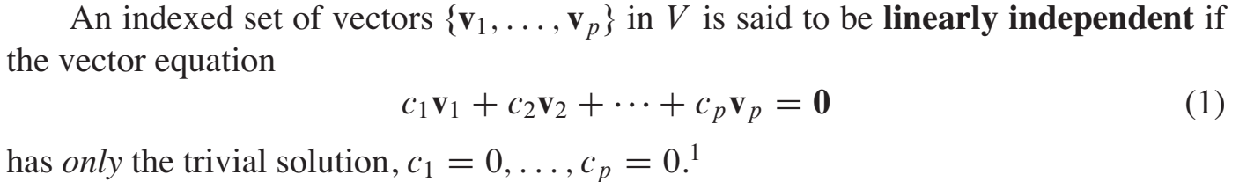
subsets that span a vector space V or a subspace H as “efficiently” as possible.

Slide 52
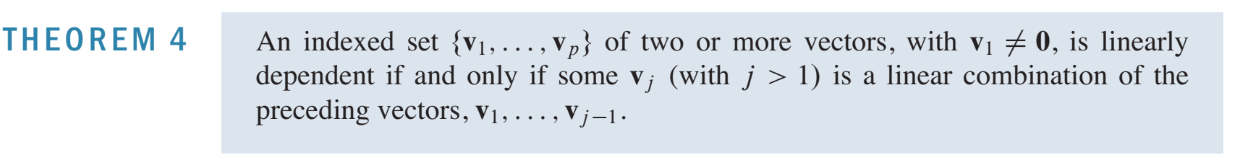
subsets that span a vector space V or a subspace H as “efficiently” as possible.

Slide 55


Slide 56
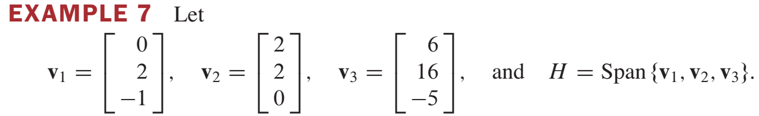

Slide 57

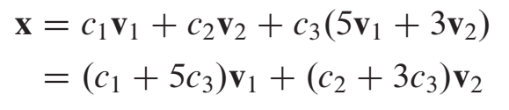
Not efficient

Slide 58
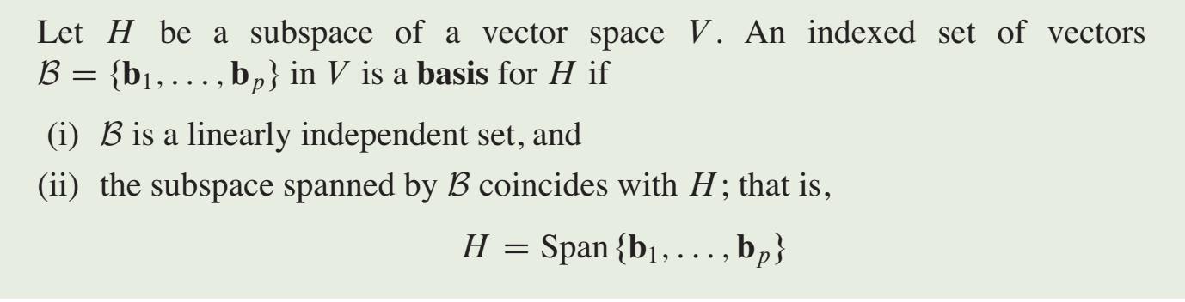

Slide 59
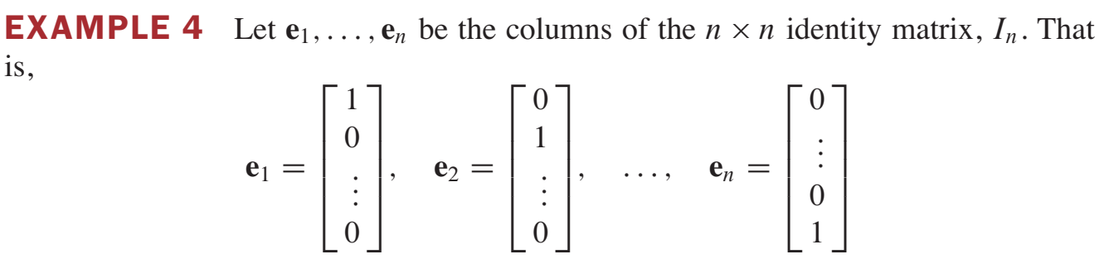

Slide 63
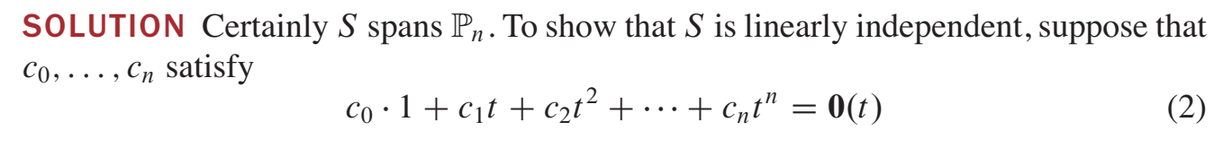

Slide 64
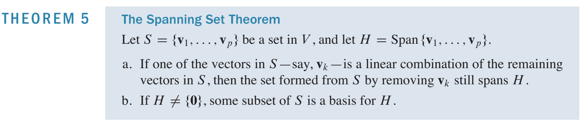

Slide 65
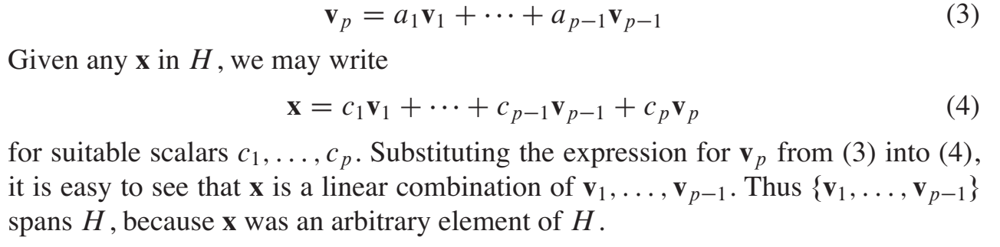

Slide 66
